Slide 1
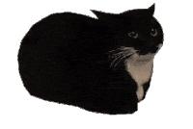

Slide 3
Computational approaches for the therapeutic target discovery to ame-liorate muscle wasting during aging and disease
Msc Karen Guerrero Vazquez
Dr. Katarzyna Whysall
Dr. Pilib O Broin

Slide 4
Recap
Diff express genes and Gene Graphs

Slide 5
Objective
Create independent models and a common model of miR-Target interactions in muscle loss during aging and critical illness based on differentially expressed (DE) miRs and genes.

Slide 6

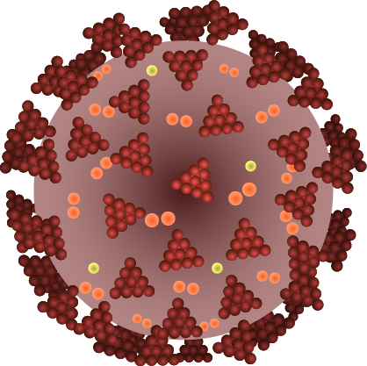
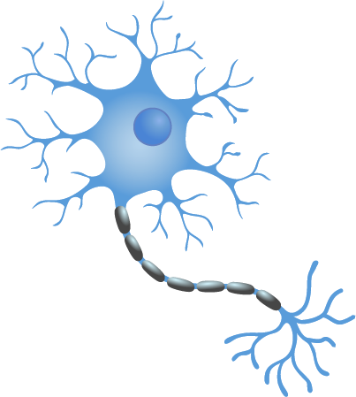
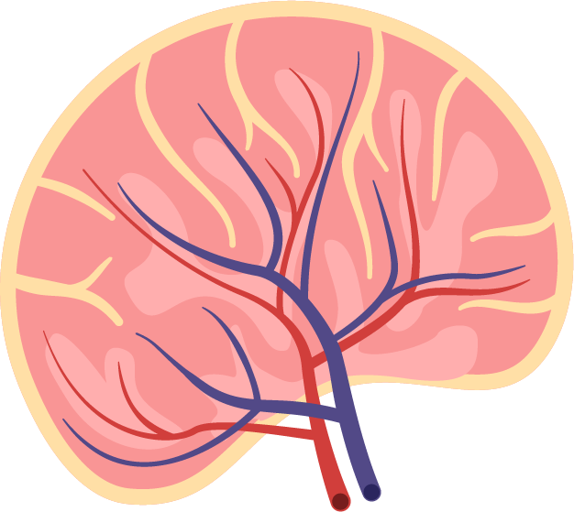
MicroRNA (miRNAs)
MicroRNAs (miRNAs) are small single-stranded RNAs that play an important role in the regulation of gene expression. Their simultaneous regulation of multiple genes and pathways and ability to deliver miRNAs into most tissues without inducing systemic immune response, makes them attractive therapeutic candidates.

Slide 7
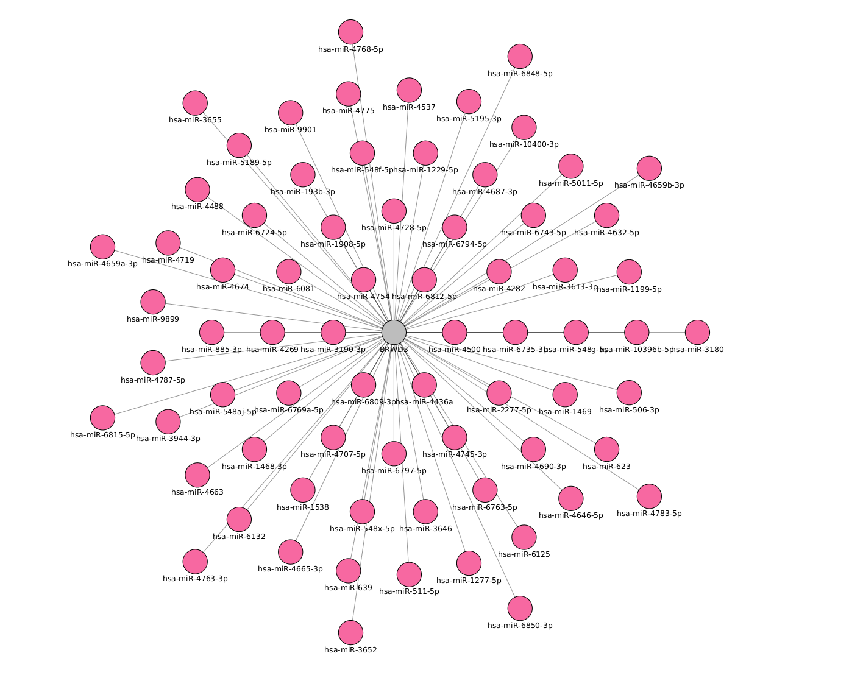
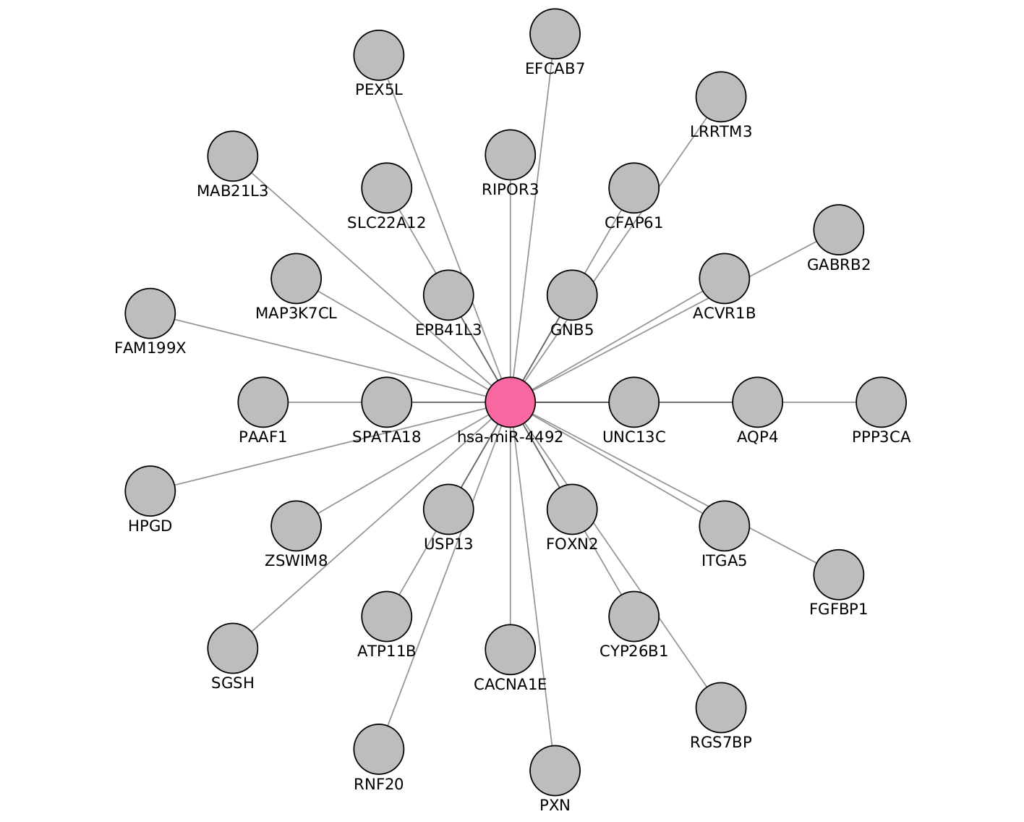
MicroRNA (miRNAs)
miRNAs are often ubiquitously expressed, have overlapping functions and can regulate multiple genes. Also, not all miRNAs are functionally relevant in a given cell type.

Slide 8
~3 – 8 %
Loss of muscle mass per decade
Brocklehurst, 1976
Notes:
. From the time you are born to around the time you turn 30, your muscles grow larger and stronger. But at some point in your 30s, you start to lose muscle mass and function. No matter the lifestyle, everybody is going to loss between 3 to 8% of muscle mass per decade after age 30, and this rate of decline is even higher after the age of 60. Sarcopenia is associated with detrimental clinical outcomes, such as a reduced quality of life, frailty, an increased risk of falls, fractures, hospitalization, and mortality.

Slide 9
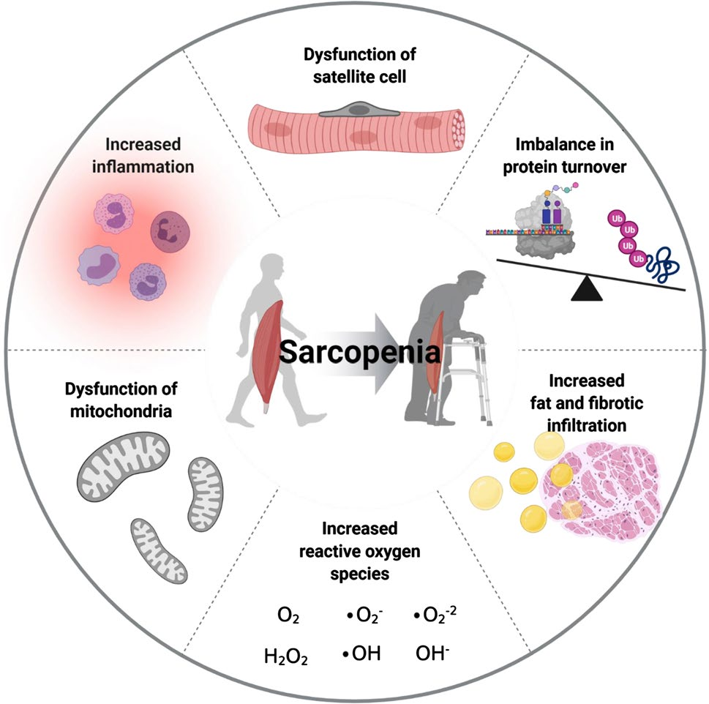
Aging and sarcopenia

Slide 10




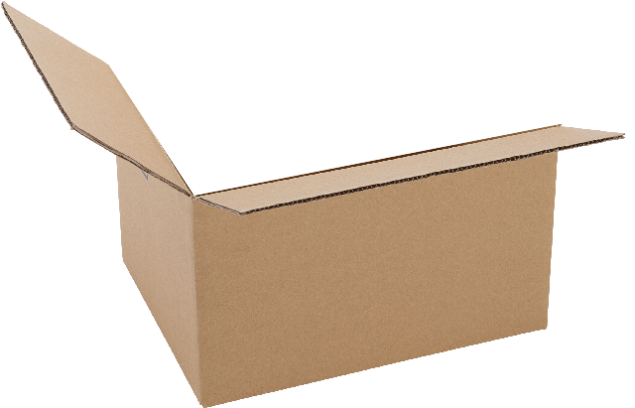

Tools to analyze miRNAs

Slide 11
Experiments
GEO number | Samples | Min Age | Max Age | Reference
GSE152558 | 5 | 41 | 85 | Tharakan, R., Ubaida-Mohien, C., Piao, Y., Gorospe, M., & Ferrucci, L. (2021).
GSE164471 | 53 | 34 | 80 | Tumasian III, R. A., Harish, A., Kundu, G., Yang, J. H., Ubaida-Mohien, C., Gonzalez-Freire, M., ... & Ferrucci, L. (2021).
GSE157585 | 136 | 19 | >65 | Kulkarni, A. S., Peck, B. D., Walton, R. G., Kern, P. A., Mar, J. C., Windham, S. T., ... & Peterson, C. A. (2020).
GSE87105 | 16 | 30 | 78 | Mercken, E. M., Capri, M., Carboneau, B. A., Conte, M., Heidler, J., Santoro, A., ... & de Cabo, R. (2017)..
GSE23527 | 36 | 29 | 76 | Drummond, M. J., McCarthy, J. J., Sinha, M., Spratt, H. M., Volpi, E., Esser, K. A., & Rasmussen, B. B. (2011)

Slide 12
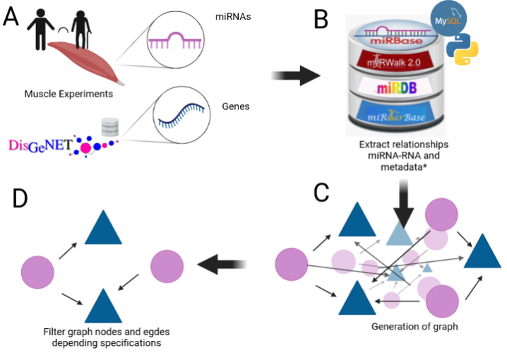
Notes:
We mentioned that aging have a lot of factors attached to it, in the specific case of Sarcopenia we can include chronic inflammation, increased reactive oxidative species, and increased fibrosis of muscle, among others have been reported to contribute to development of sarcopenia

Slide 13
Update # 3
Diff express genes and Gene Graphs

Slide 14
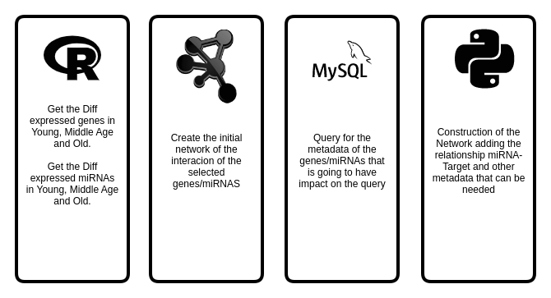
Key points

Slide 15

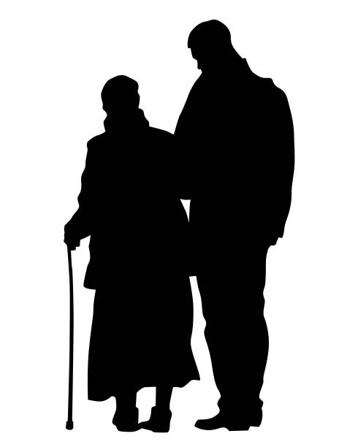

Expression during age
Middle age
Old
Young
<35>
<65>
Y
MA
O

Slide 16
My Experiments
Target | Type | N. Experiments
mRNA | RNASeq | 3
 | MicroArray | 4
miRNA | MicroArray | 1
 | miRSeq | 2
Proteomics | - | 1

Slide 17
Experiment | Evaluation | Regulation | Genes
GSE152558 | MO | Down | 9
GSE152558 | MO | UP | 8
GSE157585 | YO | Down | 73
GSE157585 | YO | UP | 9
GSE164471 | OY | Down | 8
GSE164471 | OY | UP | 5
GSE164471 | MY | Down | 2
GSE164471 | MY | UP | 2
GSE164471 | MO | Down | 11
GSE164471 | MO | UP | 6
GSE875105 | OY | Down | 88
GSE875105 | OY | Up | 18
GSE875105 | MO | Up | 6
GSE23527 | YO | Down | 5
GSE23527 | YO | Up | 1
Notes:
We mentioned that aging have a lot of factors attached to it, in the specific case of Sarcopenia we can include chronic inflammation, increased reactive oxidative species, and increased fibrosis of muscle, among others have been reported to contribute to development of sarcopenia

Slide 18

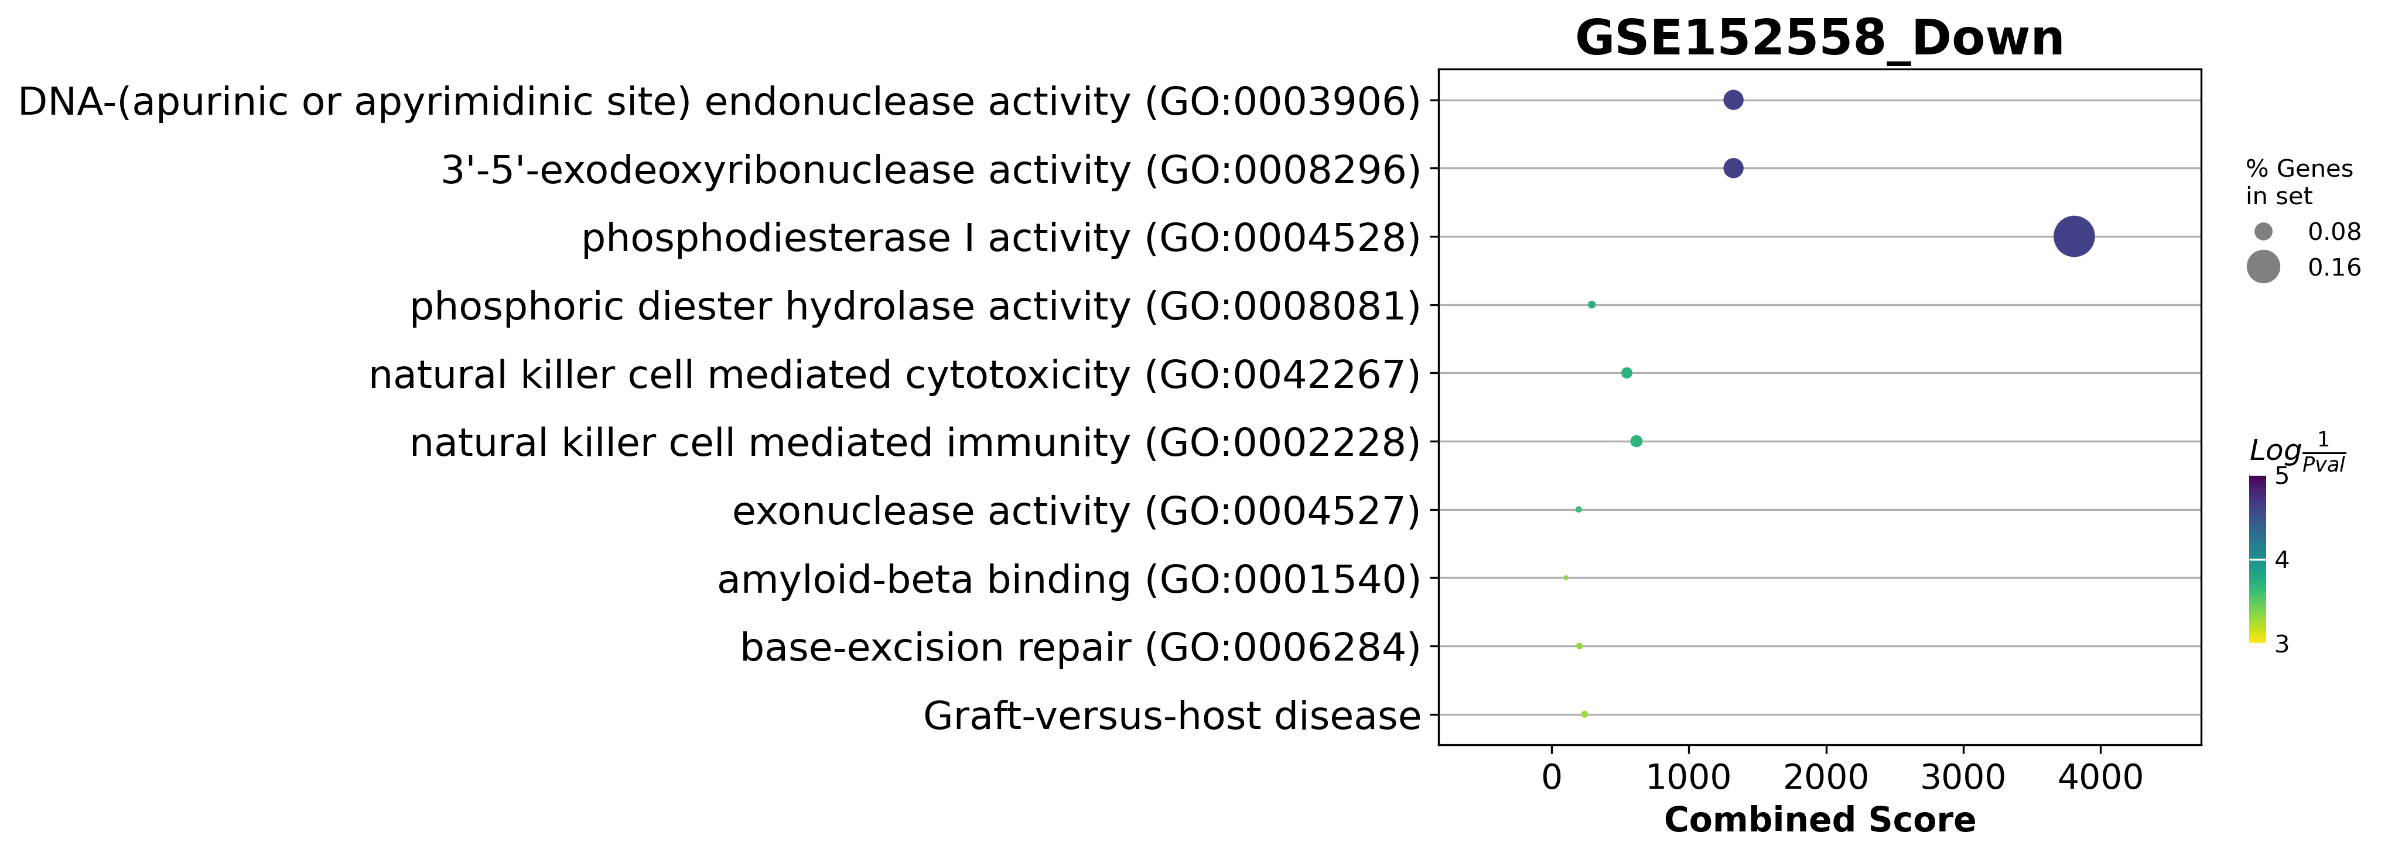
GSE152558 Dotplot

Slide 19
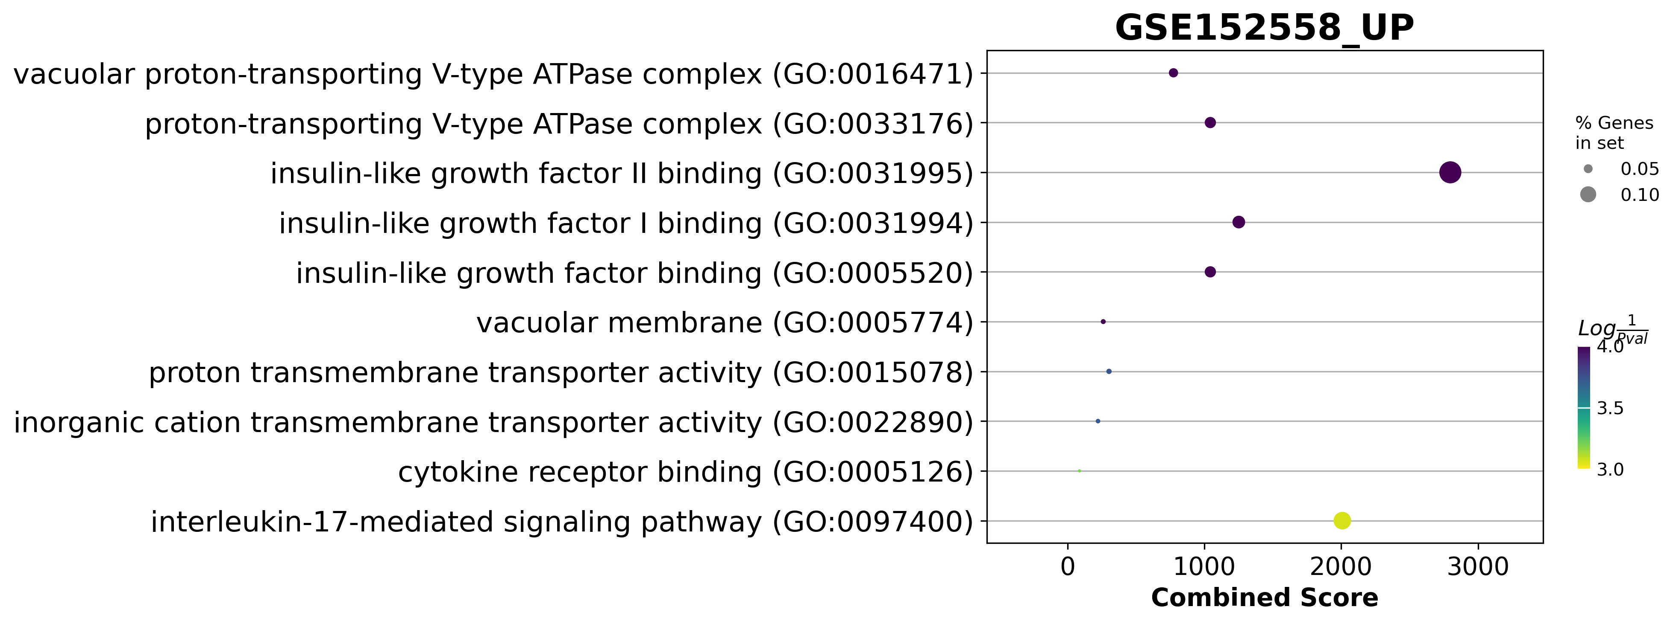
GSE152558 Dotplot

Slide 20
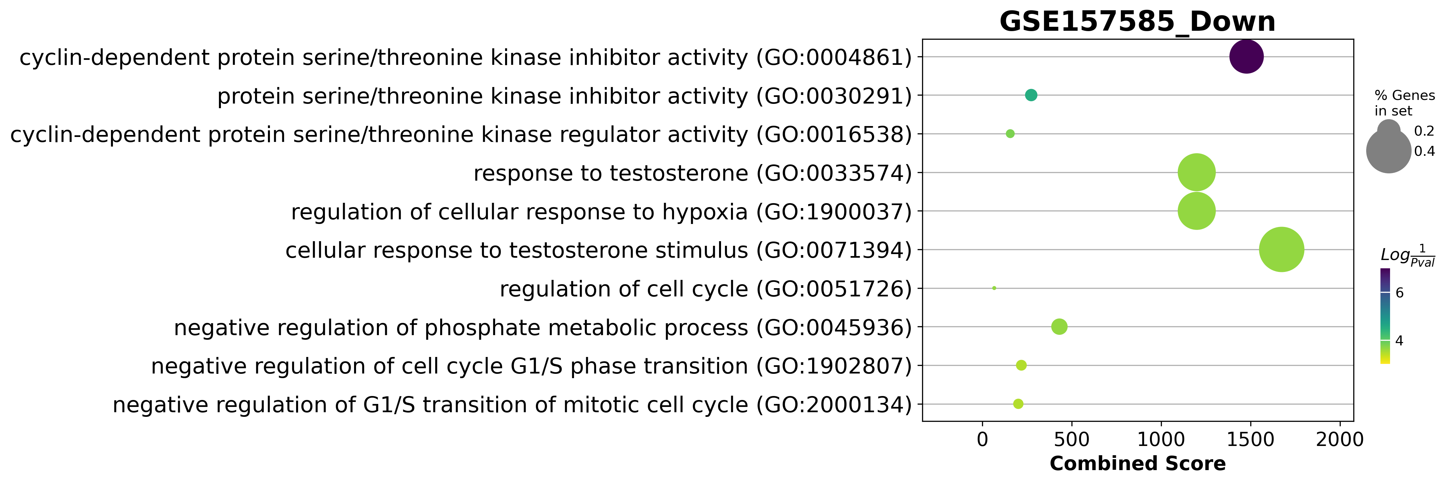
GSE157585 Dotplot

Slide 21
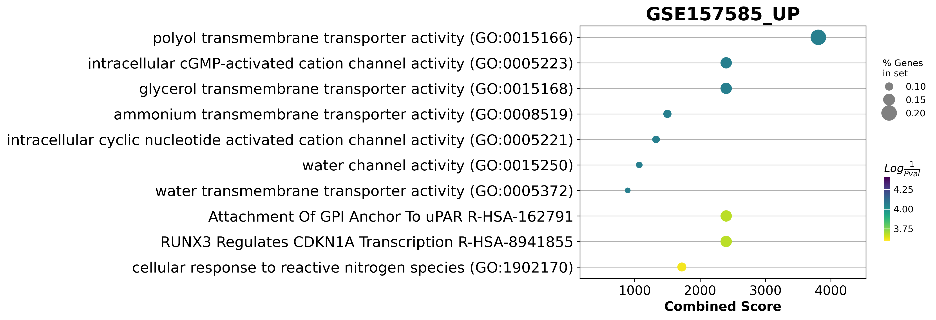
GSE157585 Dotplot

Slide 22
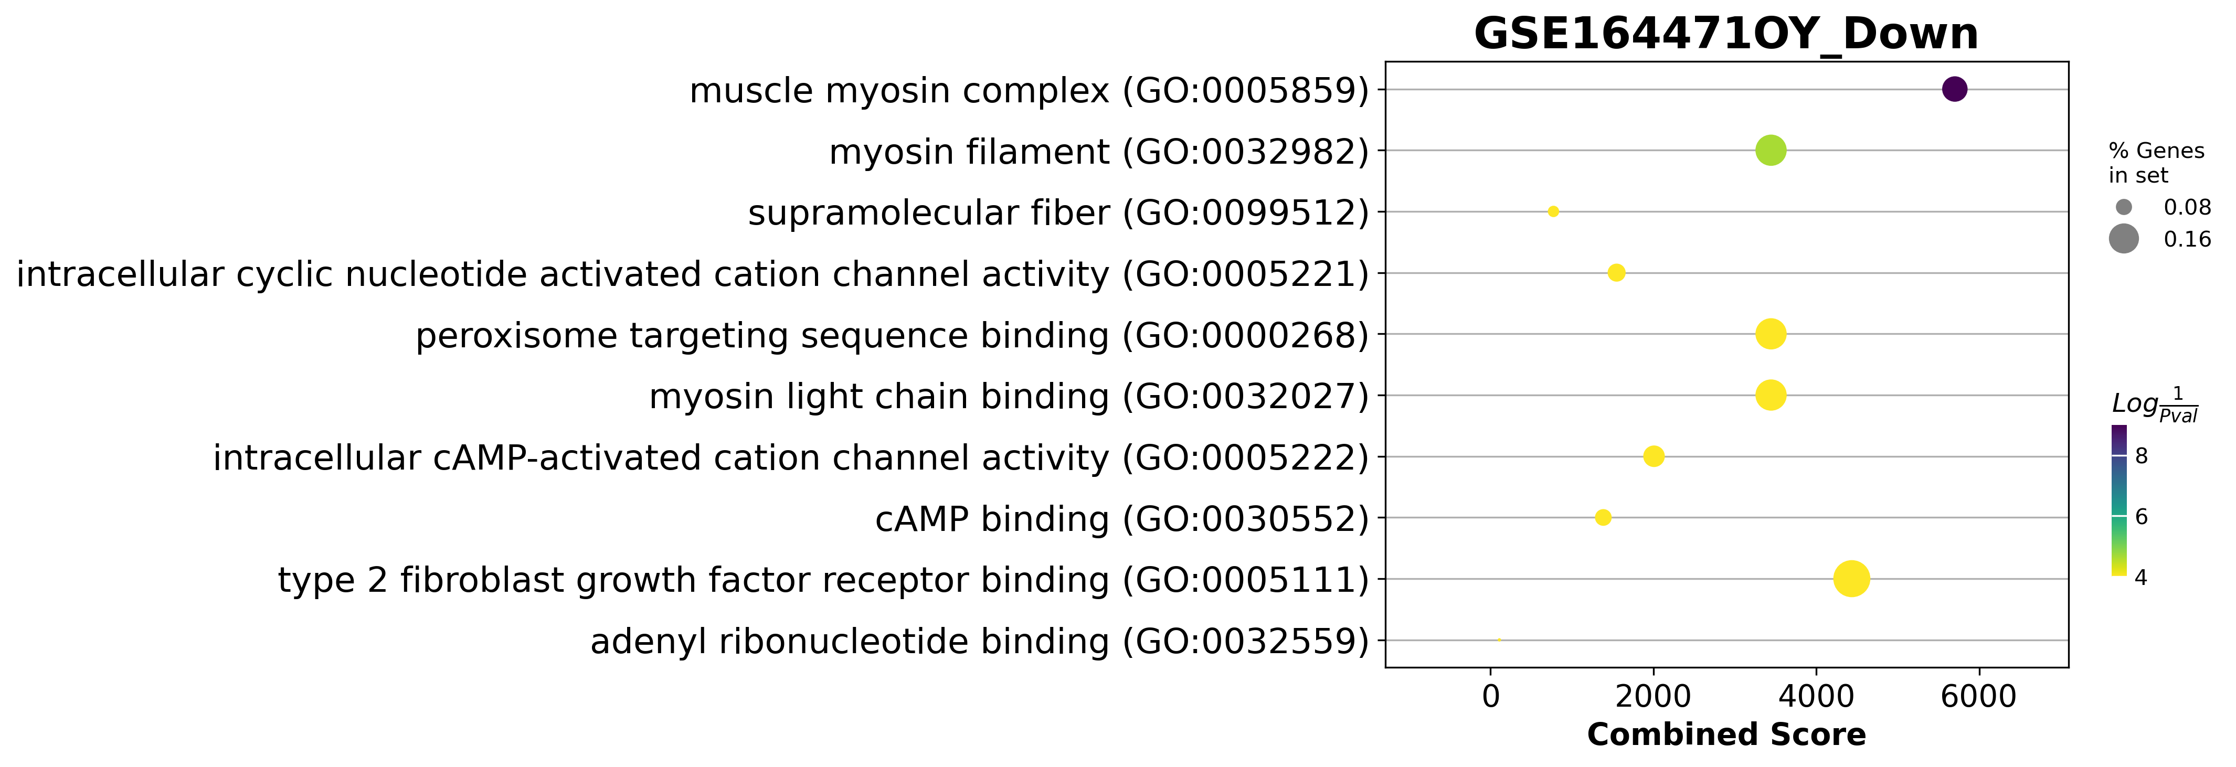
GSE164471 Dotplot

Slide 23
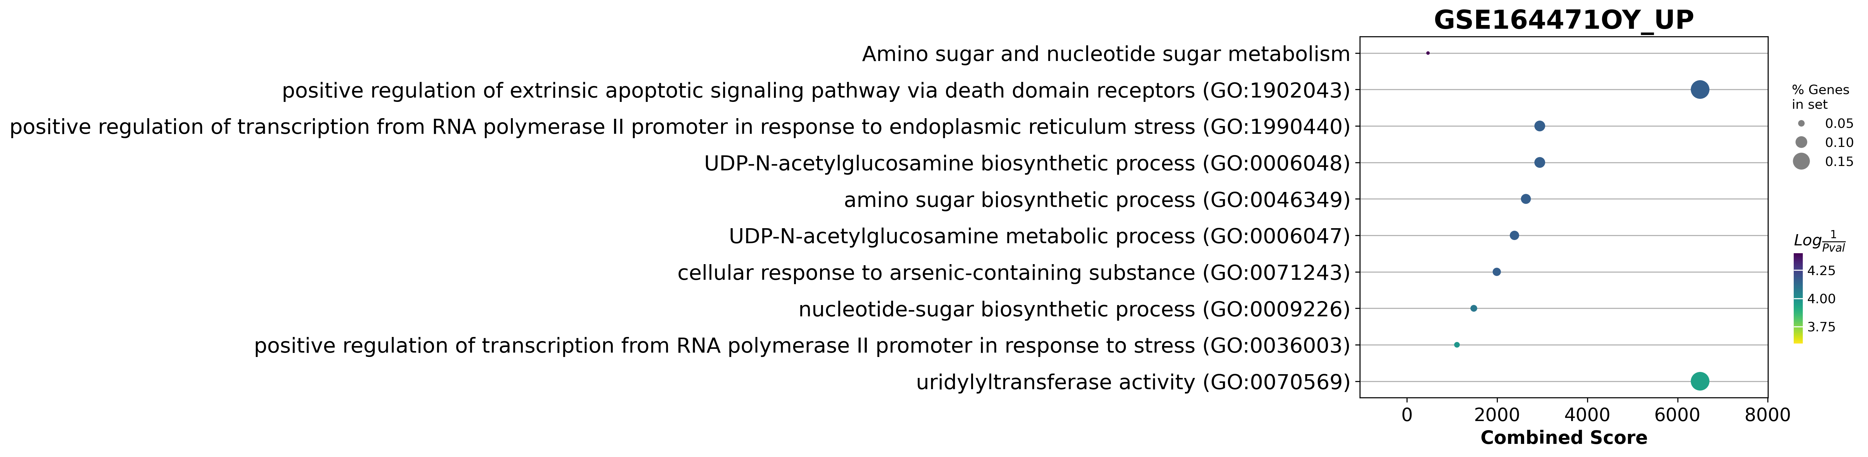
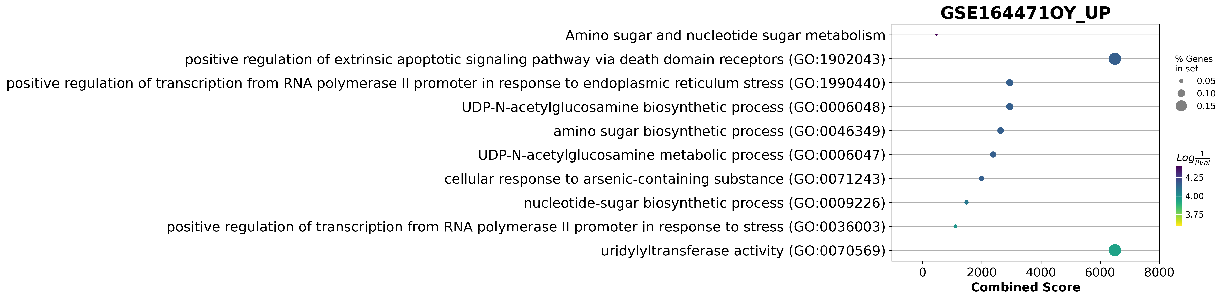
GSE164471 Dotplot
galactose to glucose

Slide 24
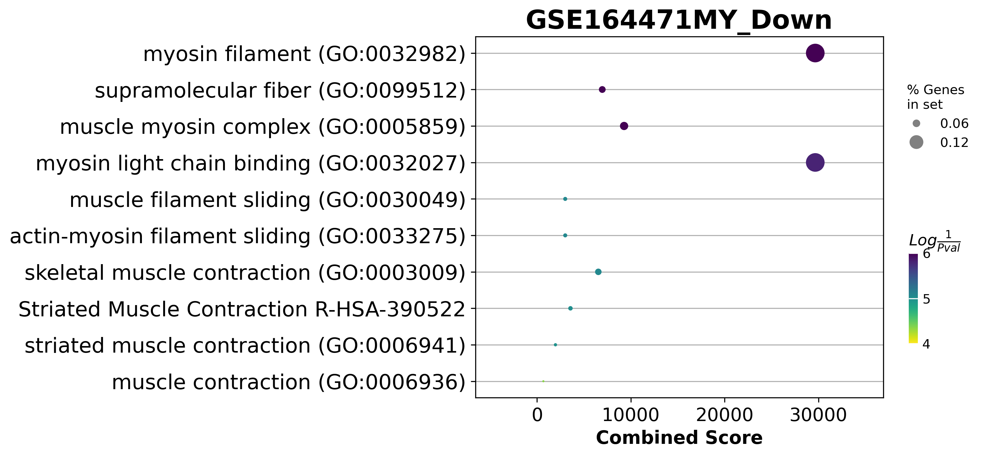
GSE164471Dotplot

Slide 25
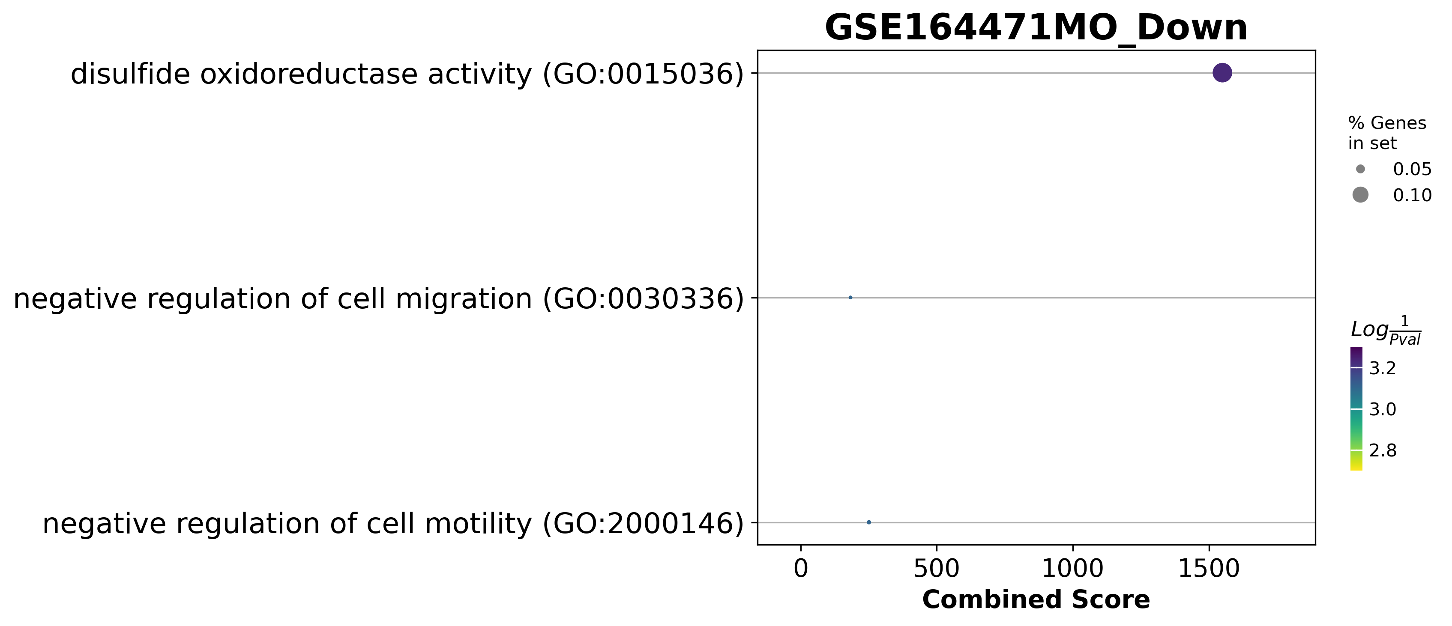
GSE164471Dotplot

Slide 26
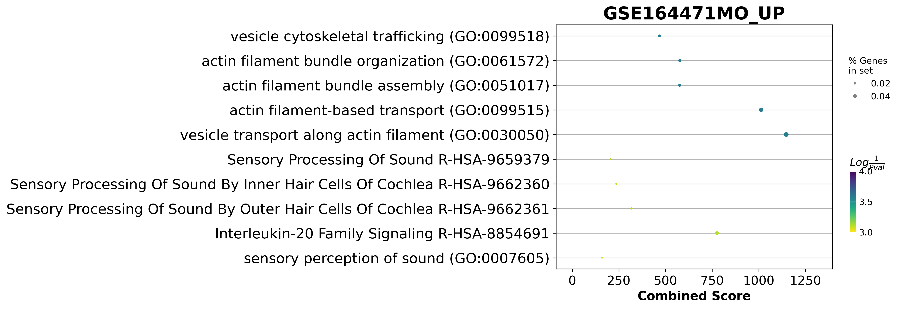
GSE164471Dotplot

Slide 27
GSE164471 was one of the best experiments
Skeletal muscle biopsies were obtained from 53 participants (22–83 years, median = 52 years)
14 Young
21 Middle age
18 Old
if they consumed medication for chronic illness
trained professionally
had a body mass index ≥ 30 kg/m2
were diagnosed with cognitive damage, a physical impairment, or a major disease.

Slide 28
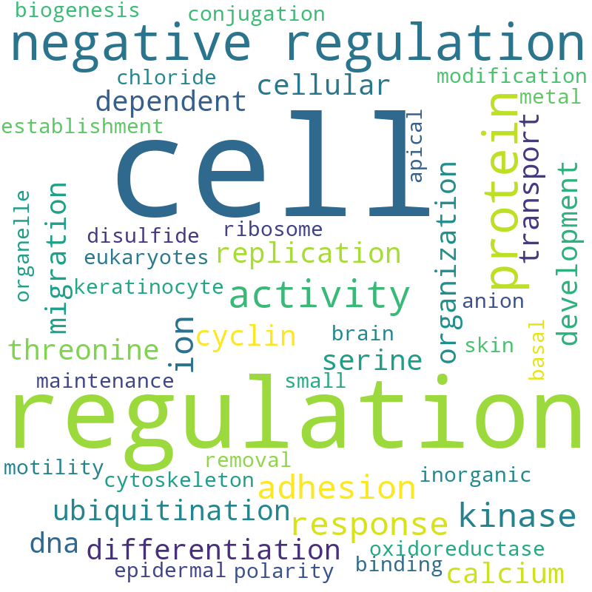
GSE164471(YO) Pathway analysis Word Cloud

Slide 29
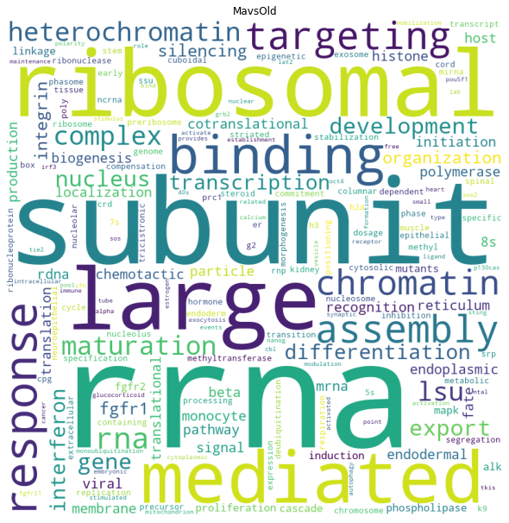
GSE164471(MO) Pathway analysis Word Cloud

Slide 30
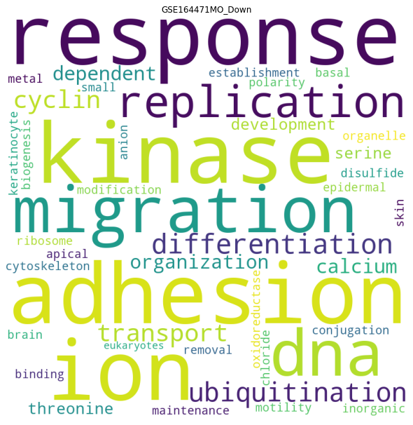
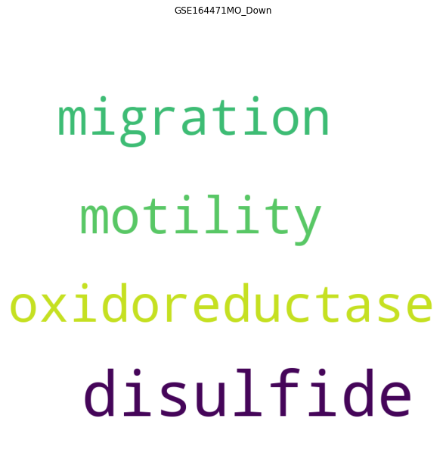
GSE164471(YM) Pathway analysis Word Cloud
Adjust p value < 0.05
Genes pathway coverture > 0

Slide 31
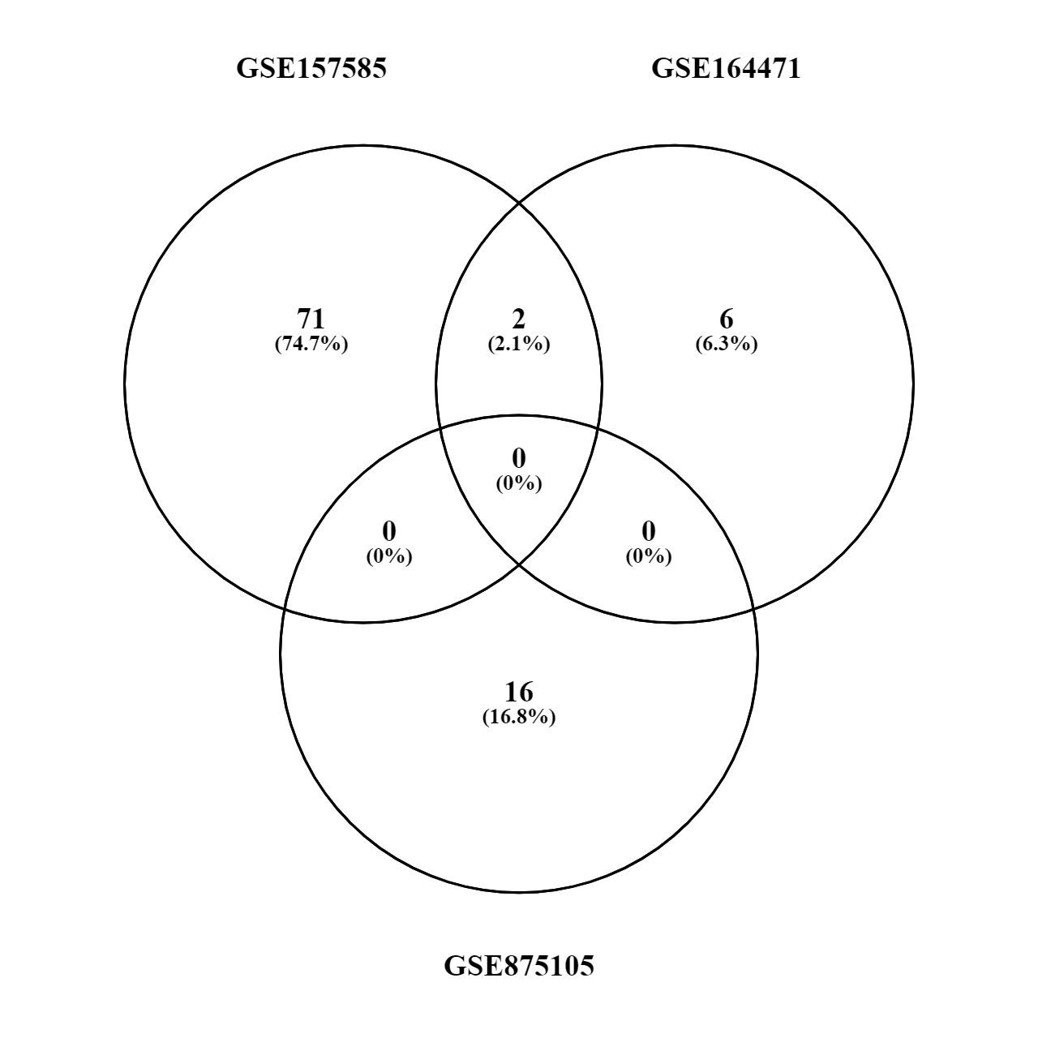
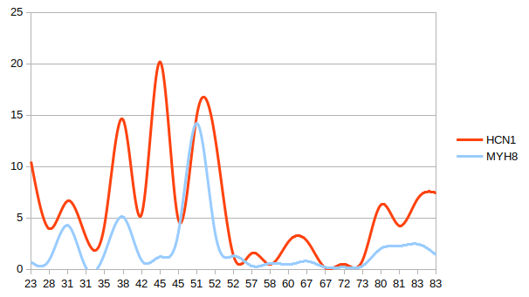
Old vs Young (up or down)
MYH8
HCN1

Slide 32
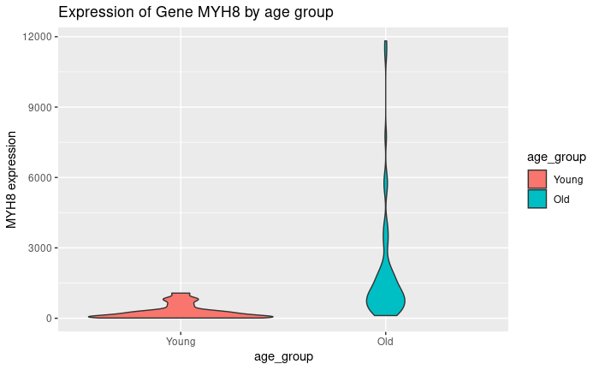
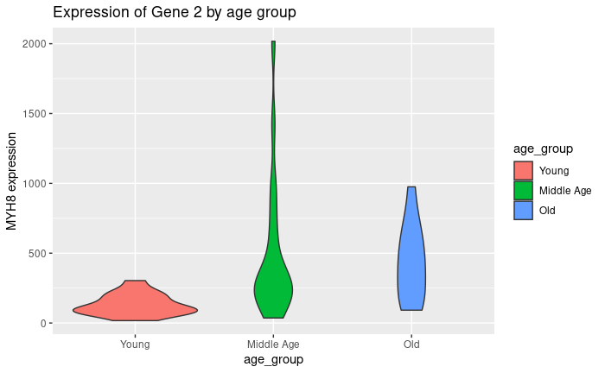
MYH8 raw count over age
GSE157585
GSE164471

Slide 33
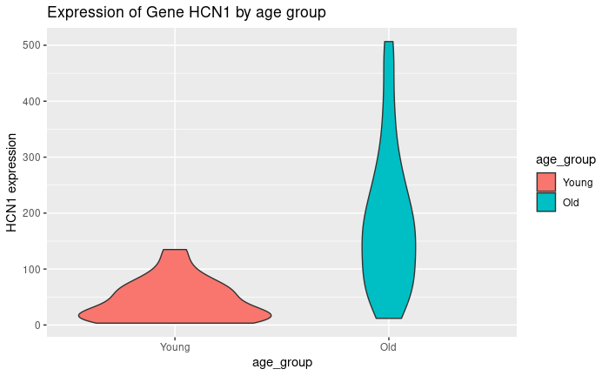
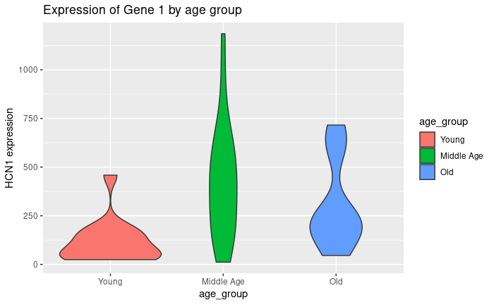
HCN1 raw count over age
GSE157585
GSE164471

Slide 34
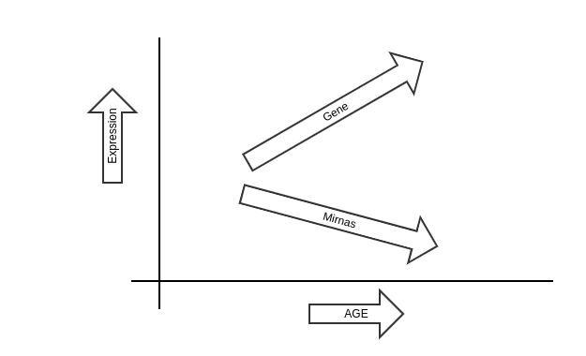
Positive slope

Slide 35
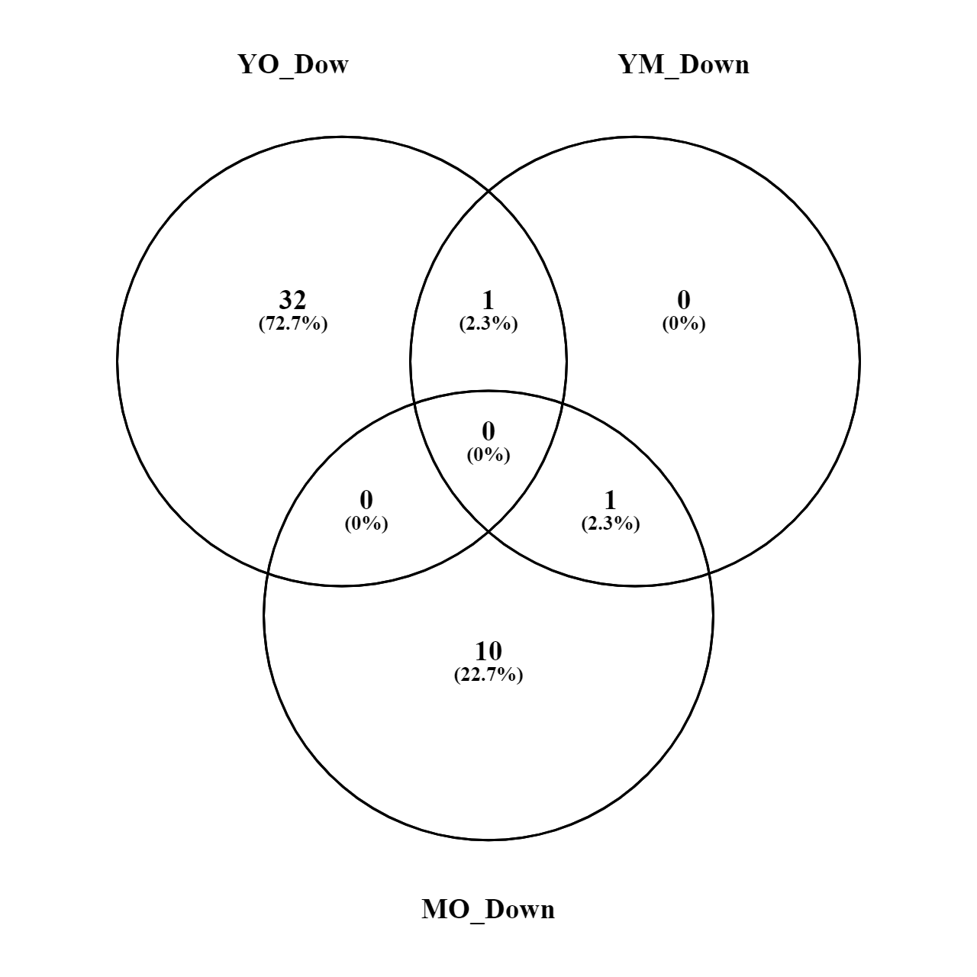
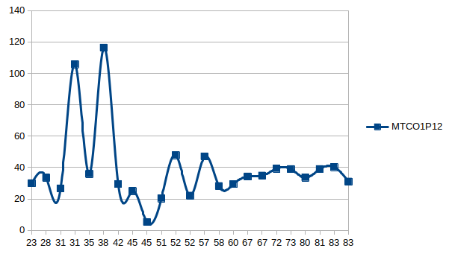
Genes increased by age
MYH8
MTCO1P12

Slide 36

Cytoscape

Slide 37
Young vs Old
YO
VS

Slide 38



Young vs Old Down-regulated
62 OG
1873 nodes
5958 edges
YO
70 OG
IntAct

Slide 39
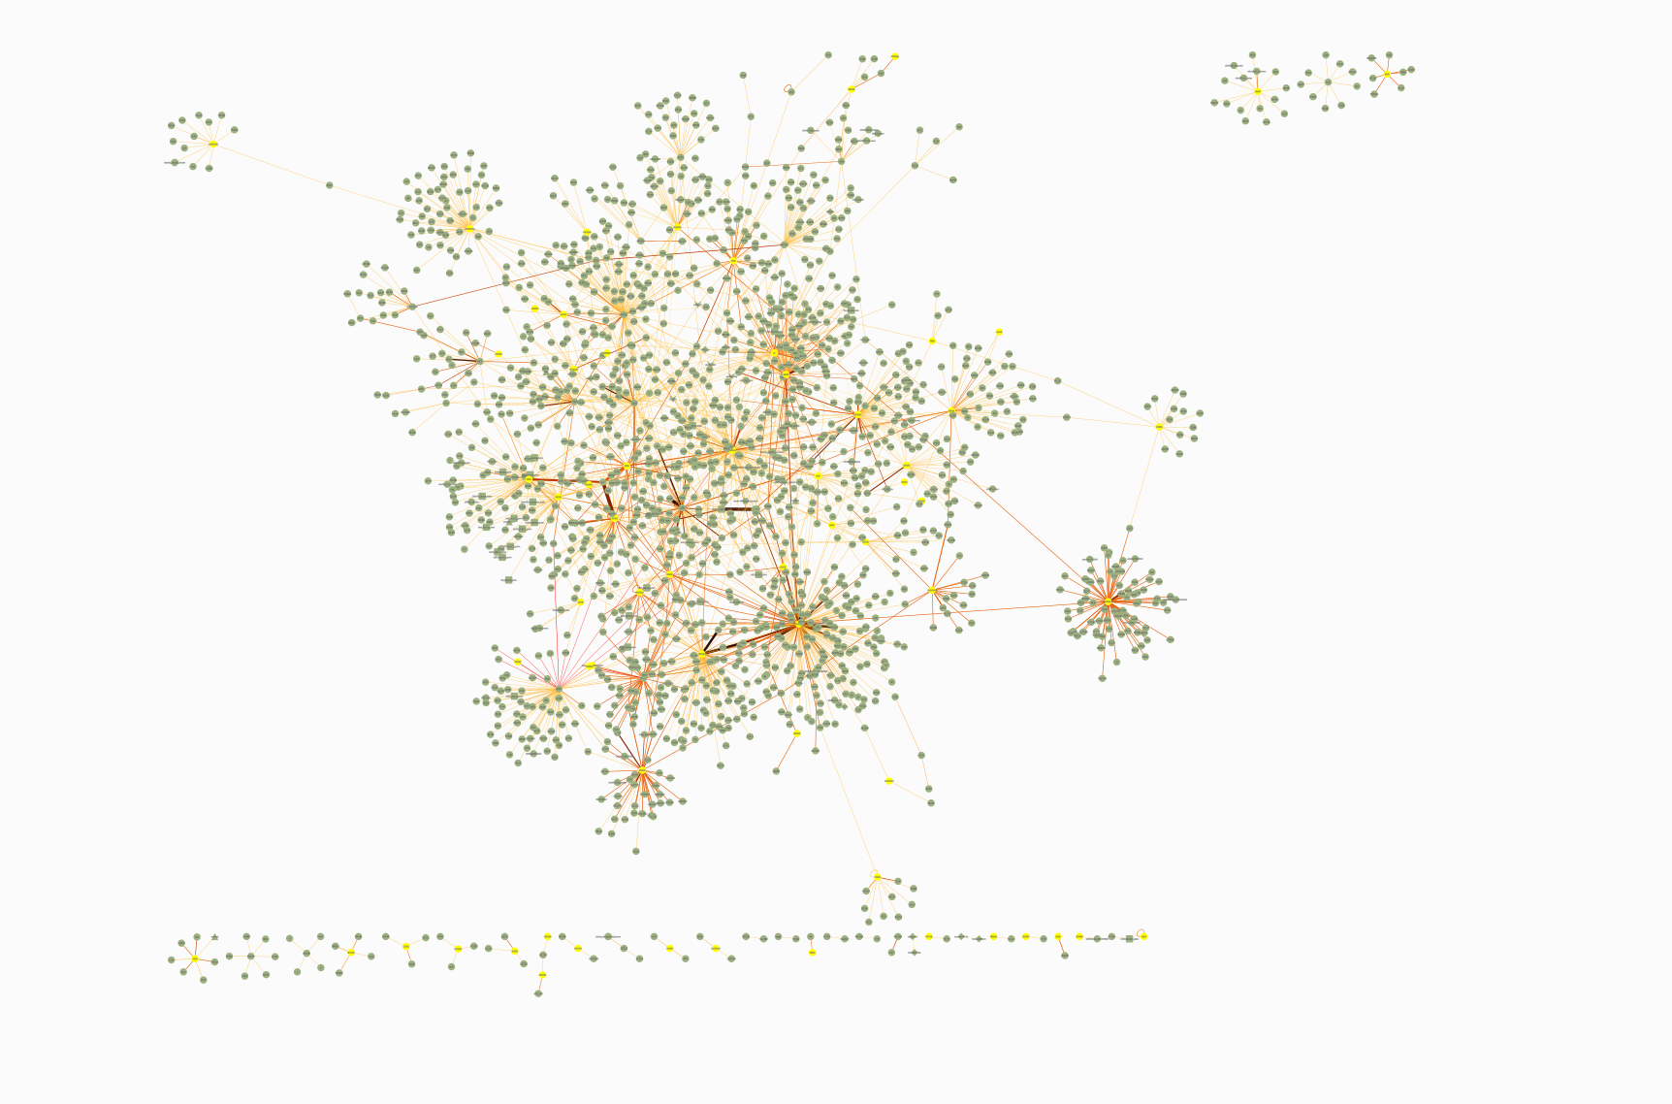
YO

Slide 40

Young vs Old Down-regulated
62 OG
1873 nodes
5958 edges
8 OG
28 miRNAs
109 nodes
287 edges
YO
70 OG
IntAct

Slide 41
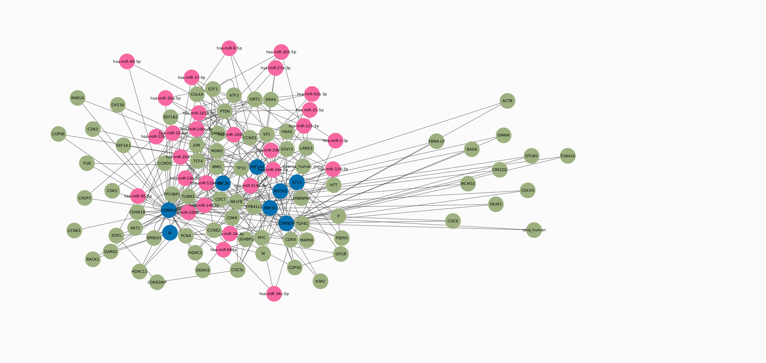
YO

Slide 42
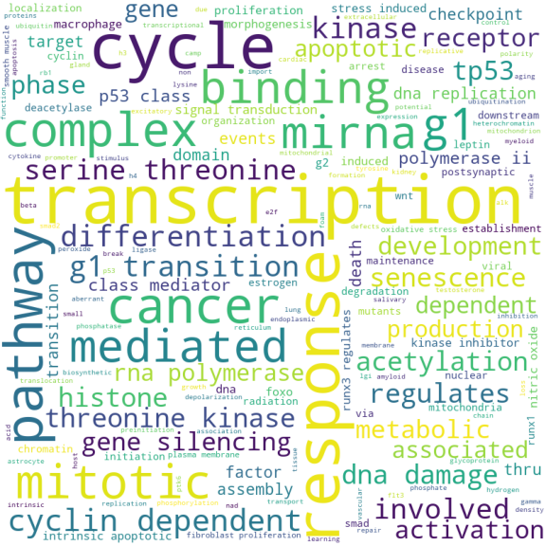
Young vs Old Down-regulated
YO

Slide 43
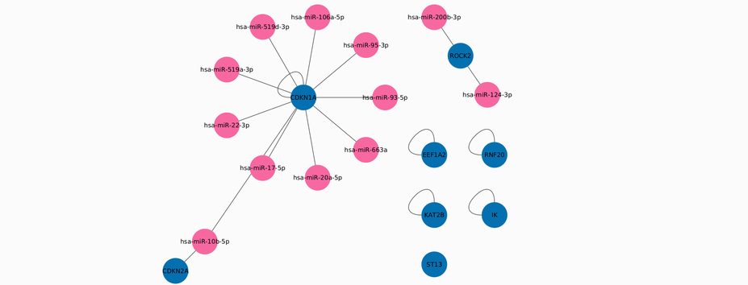
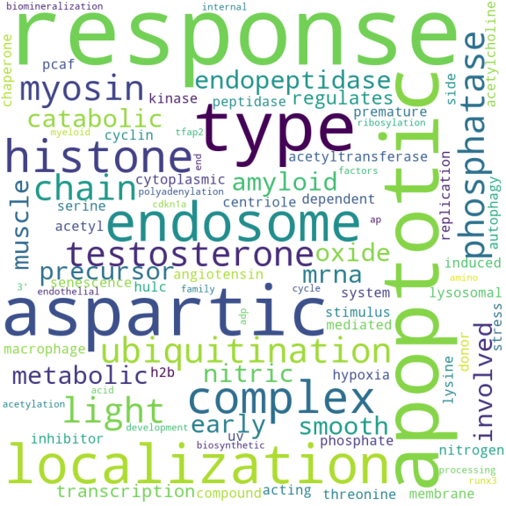
Selecting the OG genes and their connections
YO
8 OG
12 miRNAs
18 edges

Slide 44
Selecting the OG genes and their connections
YO
hsa-miR-519a-3p
hsa-miR-200b-3p
hsa-miR-10b-5p
hsa-miR-95-3p
hsa-miR-124-3p
hsa-miR-17-5p
hsa-miR-106a-5p
hsa-miR-22-3p
hsa-miR-663a
hsa-miR-519d-3p
hsa-miR-93-5p
hsa-miR-20a-5p
CDKN1A
CDKN2A
EEF1A2
IK
KAT2B
RNF20
ROCK2
ST13

Slide 45
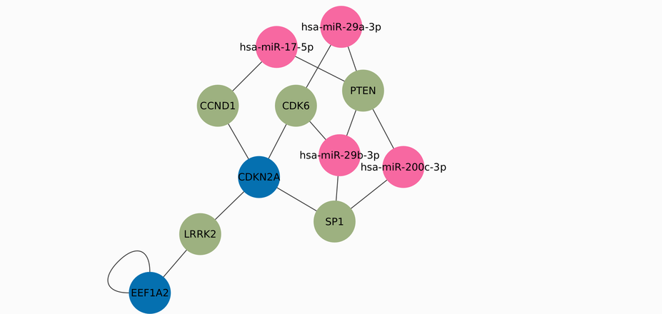
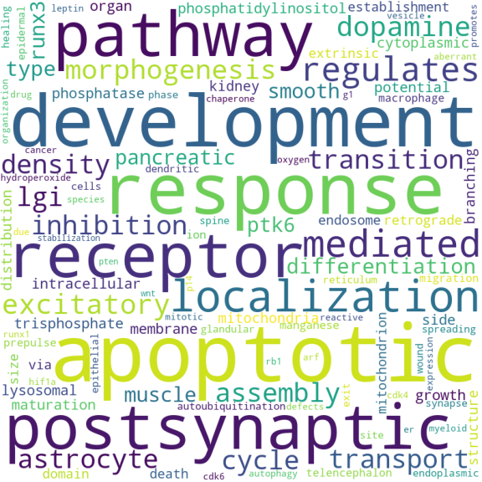
Selecting the higher connected nodes
2 OG
5 interaction genes
4 miRNAs
15 edges
YO

Slide 46
Selecting the higher connected nodes
YO
hsa-miR-200c-3p
hsa-miR-29a-3p
hsa-miR-29b-3p
hsa-miR-17-5p
EEF1A2
CDKN2A
CDK6
SP1
LRRK2
CCND1
PTEN

Slide 47
Young vs Middle Age
YM
VS

Slide 48
Young vs Middle age Down-regulated
1 OG
16 nodes
14 edges
1 OG
3 miRNAs
18 nodes
17 edges
2 OG
IntAct
YM

Slide 49
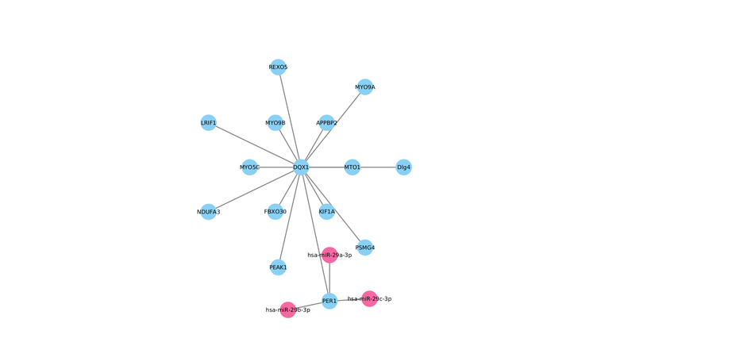
Selecting the higher connected nodes
1 OG
14 interaction genes
3 miRNAs
17 edges
YM
FAIL
hsa-miR-29a-3p
hsa-miR-29b-3p
hsa-miR-29c-3p

Slide 50
Middle Age vs Old
MO
VS

Slide 51
Middle vs Old Down-regulated
7 OG
446 nodes
1292 edges
2 OG
5 miRNAs
151 nodes
163 edges
20 OG
IntAct
MO

Slide 52
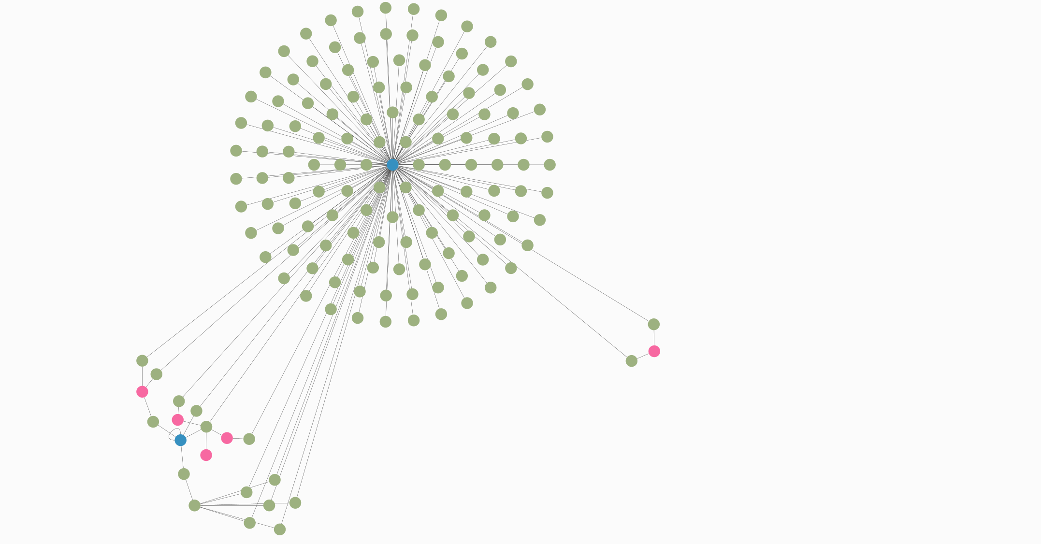
hsa-miR-124-3p
hsa-miR-137
hsa-miR-145-5p
hsa-miR-221-3p
hsa-miR-22-3p
MO

Slide 53
Middle age vs Old Down-regulated
MO

Slide 54
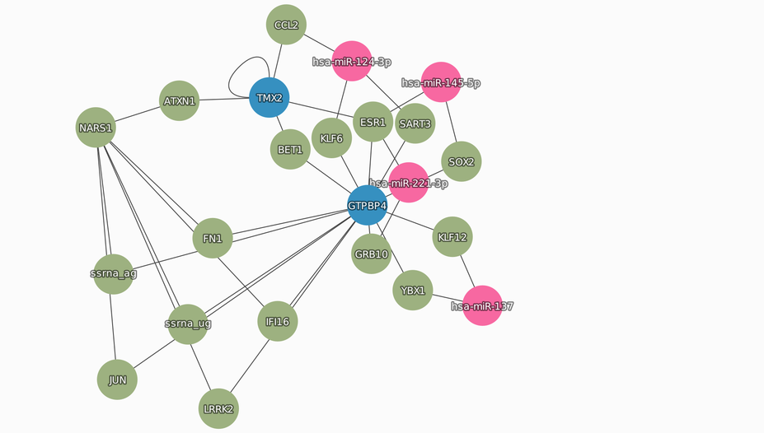
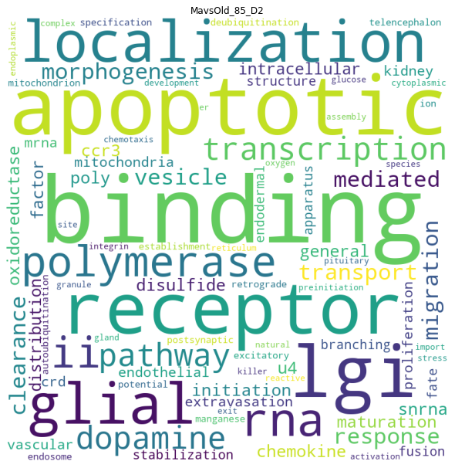
Selecting the OG genes and their connections
2 OG
2 miRNAs
19 interaction genes
35 edges
MO

Slide 55
Selecting the OG genes and their connections
ATXN1
BET1
CCL2
ESR1
FN1
GRB10
IFI16
JUN
KLF12
KLF6
LRRK2
NARS1
SART3
SOX2
YBX1
ssrna_ag
ssrna_ug
hsa-miR-221-3p
hsa-miR-145-5p
hsa-miR-137
hsa-miR-124-3p
GTPBP4
TMX2
MO

Slide 56
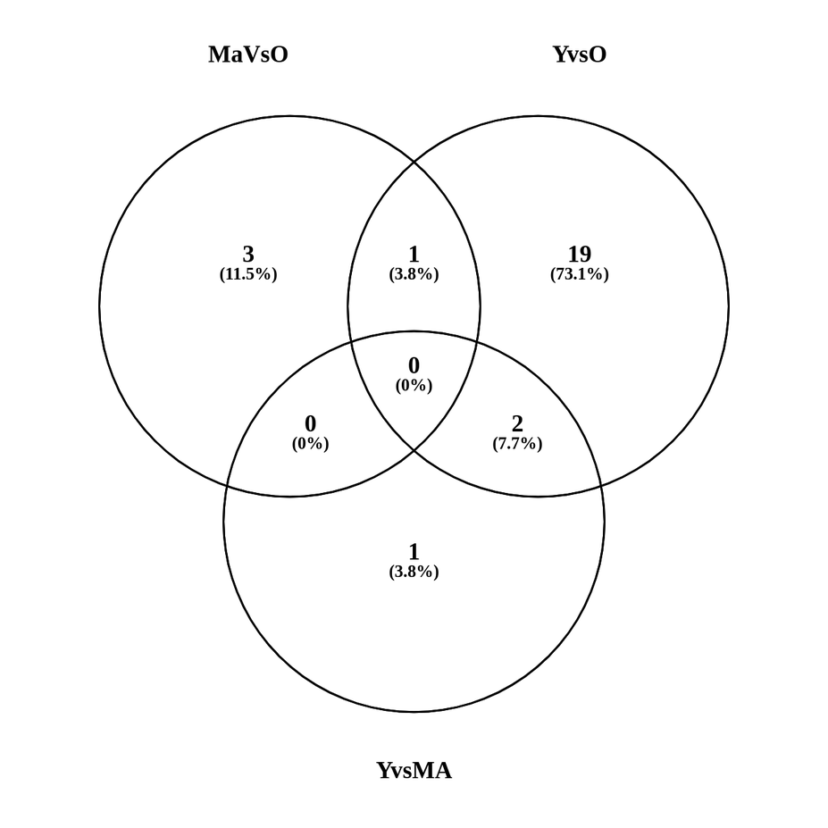
Common miRNAs
Y vsO
M vs O
Y vsO
YO
hsa-miR-29a-3p
hsa-miR-29b-3p
hsa-miR-124-3p
Y vs M
YM
Y vsO
MO
MO
MO
Y vsO
M vs O
Y vs M
Y vs M

Slide 57
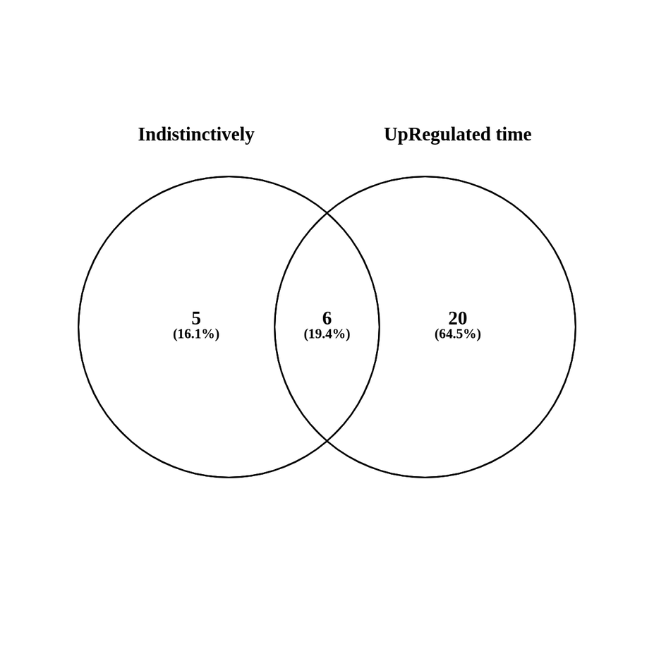
Naive (barbaric) method vs age grouping
YO
hsa-miR-200c-3p
hsa-miR-21-5p
hsa-miR-22-3p
hsa-miR-221-3p
hsa-miR-29a-3p
hsa-miR-29b-3p
YM
MO
MO
MO

Slide 58


What’s going good
The DE genes are defined for all the experiments from miRSeq, RNAseq and microArray from heathy patients.
Scripts are ready for reuse since we have raw and process data
Cytoscape is incorporated and there are plenty of apps to use.
We can get a good view on the OG, miRNAs and other interactive genes
Data like target genes, seeds and other metadata is already on the database, functional and accessible for the public
Integration of cytoscape and MySQL working
Already giving relevant mirnas

Slide 59
What can be improved
Cleaner code
Use apps with more biological information like GeneMania
Add the tissue expression data and include more minra:target databases
Use of more relevant centralities like RankPage en eigenvalue
Include more metadata in the seleccion of the nodes

Slide 60

What’s next
GeneMania
Include parsed data to the database
Improve node selection
Co-expression
Physical interactions
Shared protein domains
Pathways
Genetic interactions
Average expression of mirnas (mirnaTissueAtlas)
Add gene names to the Transcripts for miRDB and mirWalk
Add layer with MirGeneDB
Use different centralities
Apply formula to define weight including the metadata
Write a ShinyApp
Create as app for Cytoscape

Slide 61
Questions?
?

Slide 62
Thank You

Slide 63
Acknowledgements
This presentation has emanated from research conducted with the financial support of Science Foundation Ireland under Grant number [18/CRT/6214 ]

